Slide 1


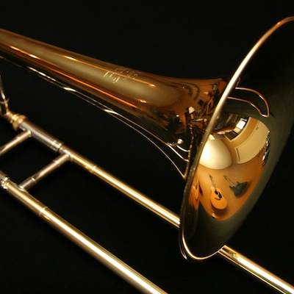
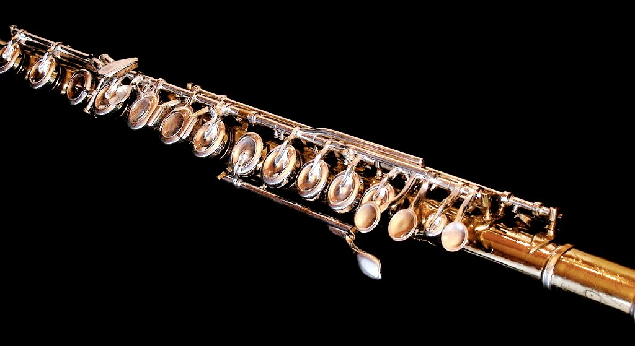




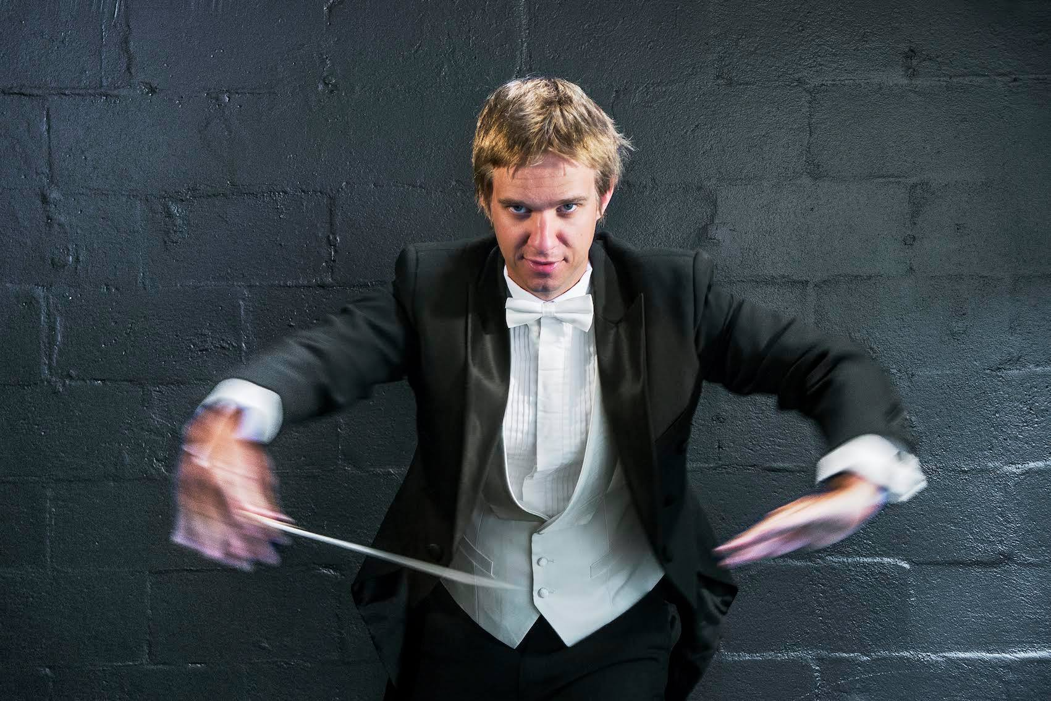
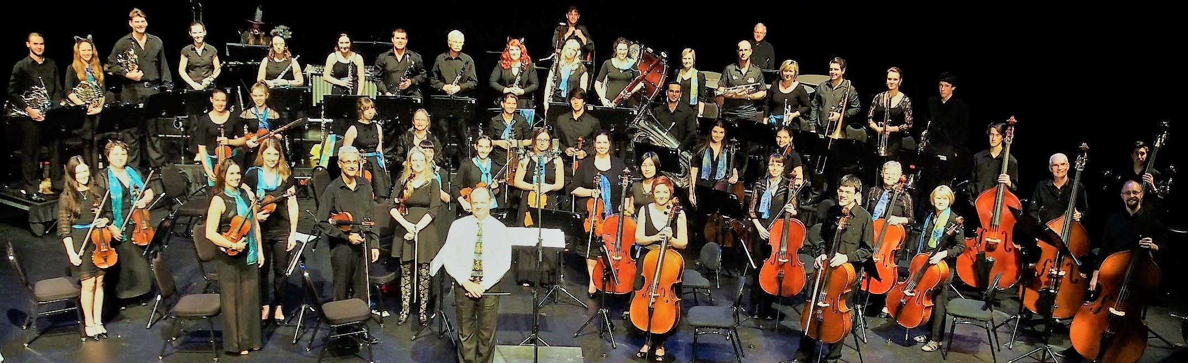

About Us | Artists & Events | Announcements | Support Us | Contacts |
Sign Up - Membership | Musical Instrument Player | Benefactor | Barrier Reef Orchestra | Barrier Reef Orchestra Players
The Barrier Reef Orchestra is a leading institution of Orchestral Music in North Queensland. It offers opportunities for players of musical instruments to learn and develop skills in an orchestral environment through performing in concerts. The Barrier Reef Orchestra is in its 17th year of performing music. The orchestra is a community organisation consisting of the musicians drawn from Townsville and other locations in North Queensland

Slide 2






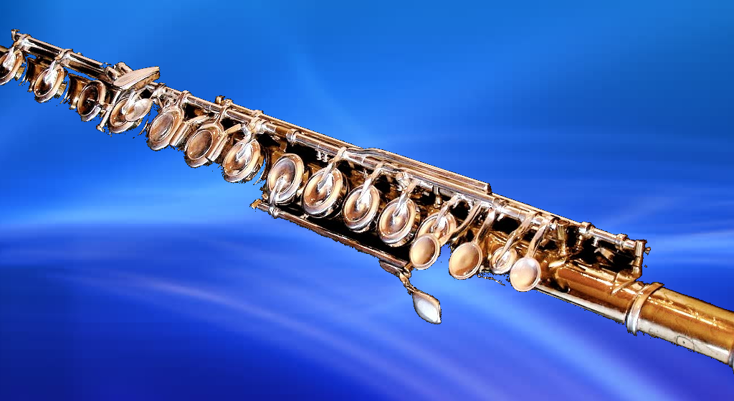
Blah Blah Blah we love music Tooting,
Whistling, Plunking and Booming

Slide 3

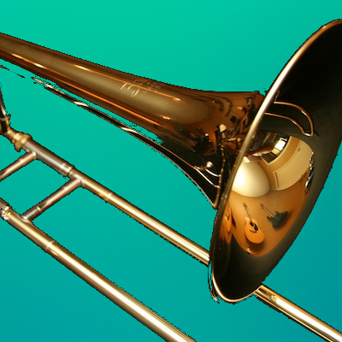
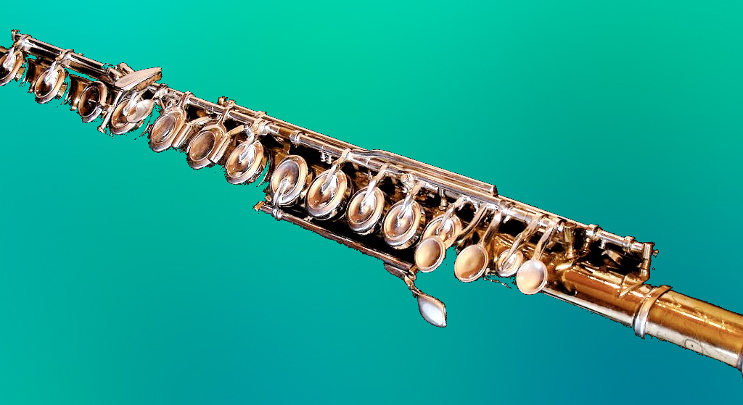




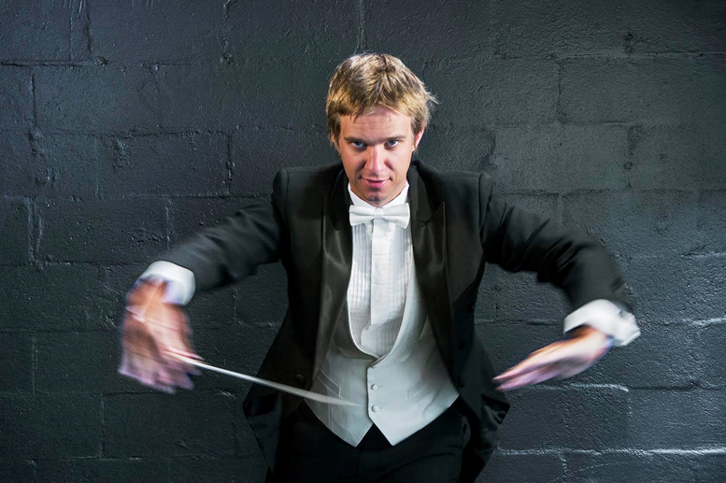
Blah Blah Blah we love music Tooting,
Whistling, Plunking and Booming

